Slide 1
Microbiology
Soil Microbiology
By
Dr. Nelson Xess
Department of Microbiology
Bhanupratap Deo Govt. P.G College, Kanker, Chhattisgarh

Slide 2
Soil as an environmental culture medium
Soil contains air, free water, organic matter and mineral matters which are essential for the growth of microorganisms. On a volume basis, well-drained soil may contain 40% water, which is available to soil microbes for respiration and growth. The water in good agricultural soil may be considered a dilute nutrient broth. It contains, in solution, ion like K ⁺, Na ⁺ , Mg ²⁺ , Ca²⁺, Fe ³⁺, NO₃– , SO₄²⁻ , CO₃²⁻ , PO₄³⁻ and others.
Like water, soil also contains 25% air. Most soil bacteria are aerobic to facultative and practically all actinomycetes and molds require free oxygen for their respiration and growth.
The pH of top good soil ranges from 6.0 to 8.0 at which most kinds of soil microorganisms grow best.

Slide 3
The temperature of soil varies from day to day, controlled by climate. Most soil microbes grow best at temperature between 15-45ºC (Mesophiles) while psychrophiles grow at lower temperature and thermophiles grow at higher temperature.
Available free oxygen, hydrogen donor and acceptor play a vital role in microbial growth.

Slide 4
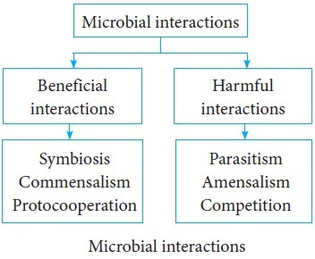
Microbial interactions

Slide 5
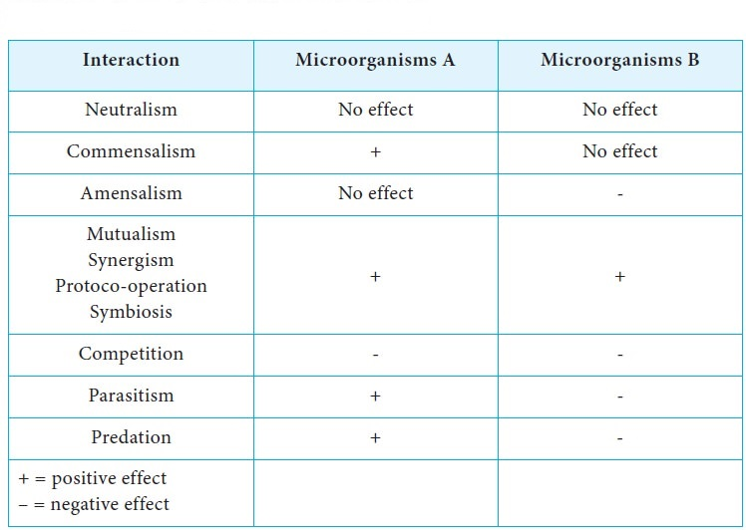
Types of Microbial interaction in soil

Slide 6
Symbiosis
symbiotic relationships are arrangements that are mutually beneficial to both organisms.
Symbiotic communities in root nodules
Another example of symbiotic mutualism is the bacteria of the genus Rhizobium which colonizes the root nodules of leguminous plants. Again, the bacteria benefit from the hospitable growth environment, producing nitrates from nitrogen gas which the plant can use (it is unable to use the gaseous form of nitrogen.) This symbiotic relationship is highly advantageous for both microbe and host.
Colonization of skin by beneficial bacteria
Bacteria of the genera Staphylococcus and Streptococcus colonize the skin of humans and other animals. This relationship is beneficial to the bacteria because they have a ready supply of nutrients and in turn, they protect the surface of the skin from colonization by pathogens and other less desirable micro-organisms.

Slide 7
Mutualism
It is defined as the relationship in which each organism in interaction gets benefits from association. It is an obligatory relationship in which mutualist and host are metabolically dependent on each other.
Mutualistic relationship is very specific where one member of association cannot be replaced by another species.
Mutualism require close physical contact between interacting organisms.
Relationship of mutualism allows organisms to exist in habitat that could not occupied by either species alone.
Mutualistic relationship between organisms allows them to act as a single organism.

Slide 8
Examples of mutualism:
  Lichens:
    Lichens are excellent example of mutualism.
    They are the association of specific fungi and certain genus of algae. In lichen, fungal partner is called mycobiont and algal partner is called
    Phycobiont is member of cycanobacteria ad green algae (Trabauxua).
    Because phycobionts are photoautotrophs, the fungus get its organic carbon directly from algal partner, in turn fungi protects the phycobiont from extreme conditions and also provide water and minerals to algae.
    Lichen grow very slowly but are able to colonies habitat that do not permit the growth of other organisms.
    Most lichens are resistant to high temperature and drying.

Slide 9
Commensalism
It is a relationship in which one organism (commensal) in the association is benefited while other organism (host) of the association is neither benefited nor harmed.
It is an unidirectional association and if the commensal is separated from the host, it can survive.
Ex. - Non-pathogenic coli in intestinal tract of human:
E. coli is a facultative anaerobe that uses oxygen and lower the O2 concentration in gut which creates suitable environment for obligate anaerobes such as Bacteroides. E. coli is a host which remains unaffected by Bacteroides.

Slide 10
Competition
The competition represents a negative relationship between two microbial population in which both the population are adversely affected with respect to their survival and growth.
Competition occurs when both population uses same resources such as same space or same nutrition, so, the microbial population achieve lower maximum density or growth rate.
Microbial population competes for any growth limiting resources such as carbon source, nitrogen source, phosphorus, vitamins, growth factors etc.
Competition inhibits both population from occupying exactly same ecological niche because one will win the competition and the other one is eliminated.

Slide 11
Examples of competition
Competition between Paramecium cadatum and Paramecium aurelia:
  Both species of Paramecium feeds on same bacteria population when these protozoa are placed together.
  P. aurelia grow at better rate than P. caudatum due to competition.

Slide 12
Parasitism
It is a relationship in which one population (parasite) get benefited and derive its nutrition from other population (host) in the association which is harmed.
The host-parasite relationship is characterized by a relatively a long period of contact which may be physical or metabolic.
Some parasite lives outside host cell, known as ectoparasite while other parasite lives inside host cell, known as endoparasite.
Ex.- Viruses:
Viruses are obligate intracellular parasite that exhibit great host specificity.
There are may viruses that are parasite to bacteria (bacteriophage), fungi, algae, protozoa etc.

Slide 13
Predation
It is a wide spread phenomenon when one organism (predator) engulf or attack other organism (prey).
The prey can be larger or smaller than predator and this normally results in death of prey.
Normally predator-prey interaction is of short duration.
Ex.- Protozoan-bacteria in soil:
Many protozoans can feed on various bacterial population which helps to maintain count of soil bacteria at optimum level

Slide 14
Rhizosphere
Rhizosphere also known as the microbe storehouse is the soil zone surrounding the plant roots where the biological and chemical features of the soil are influenced by the roots.
or
The region of the soil contact with the roots of plant. It contains many microorganisms and its composition is affected by root activities. It is an environment under the influence of plant.
The rhizosphere is the zone surrounding the root of plants in which complex relations exist among the plant, the soil microorganisms and the soil itself.

Slide 15
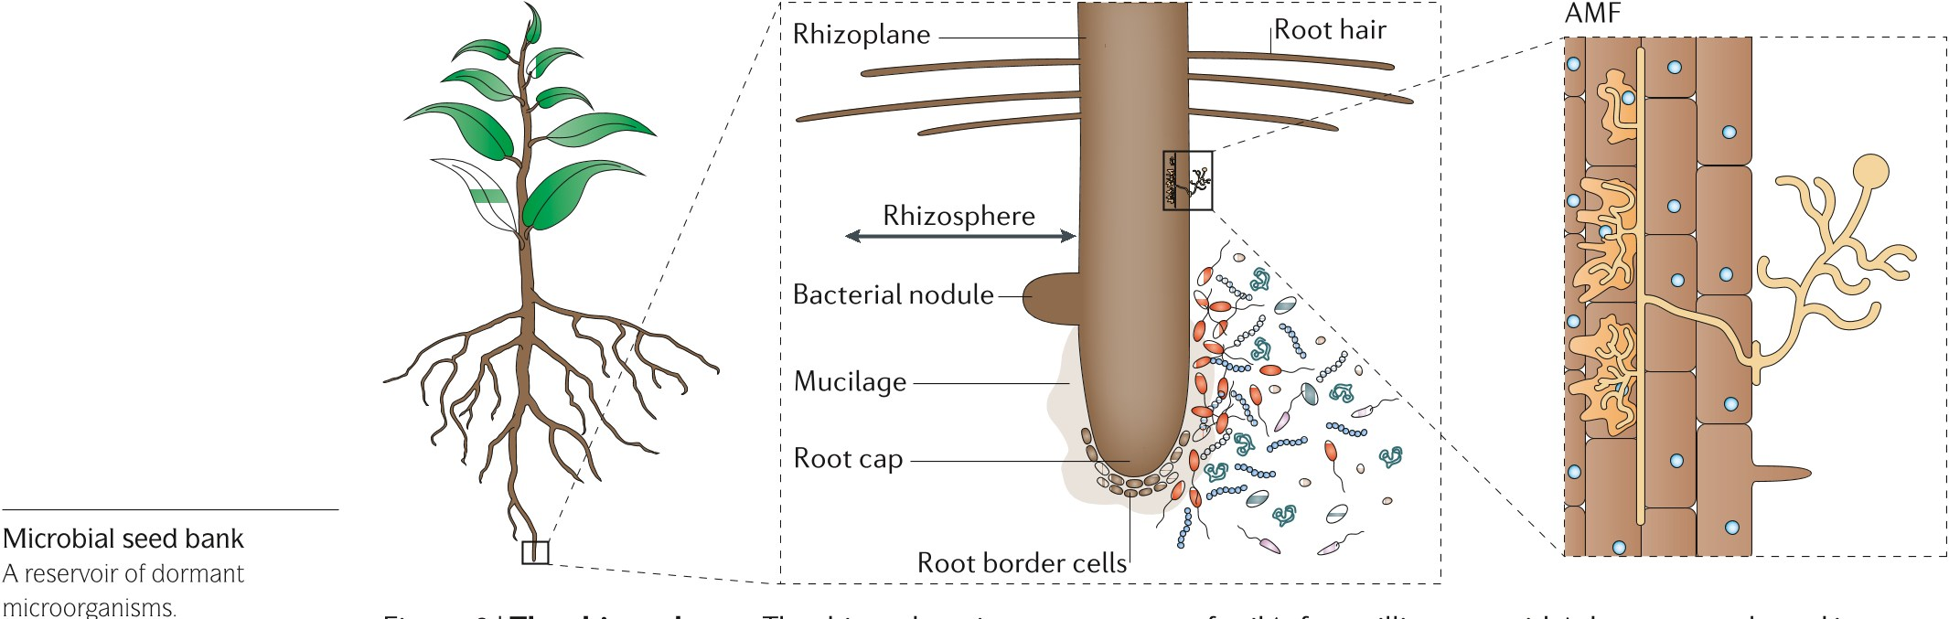
Rhizosphere

Slide 16
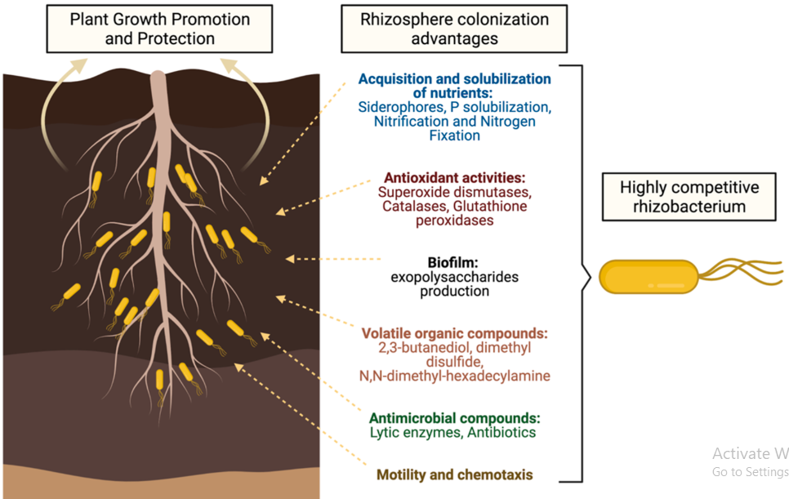
Concept and role of microbes

Slide 17
Mycorrhizae
Mycorrhizae are a symbiotic association between plant roots and fungi. Their major role is to enhance nutrient and water uptake by the host plant by exploiting a larger volume of soil than roots alone can do.

